Slide 1
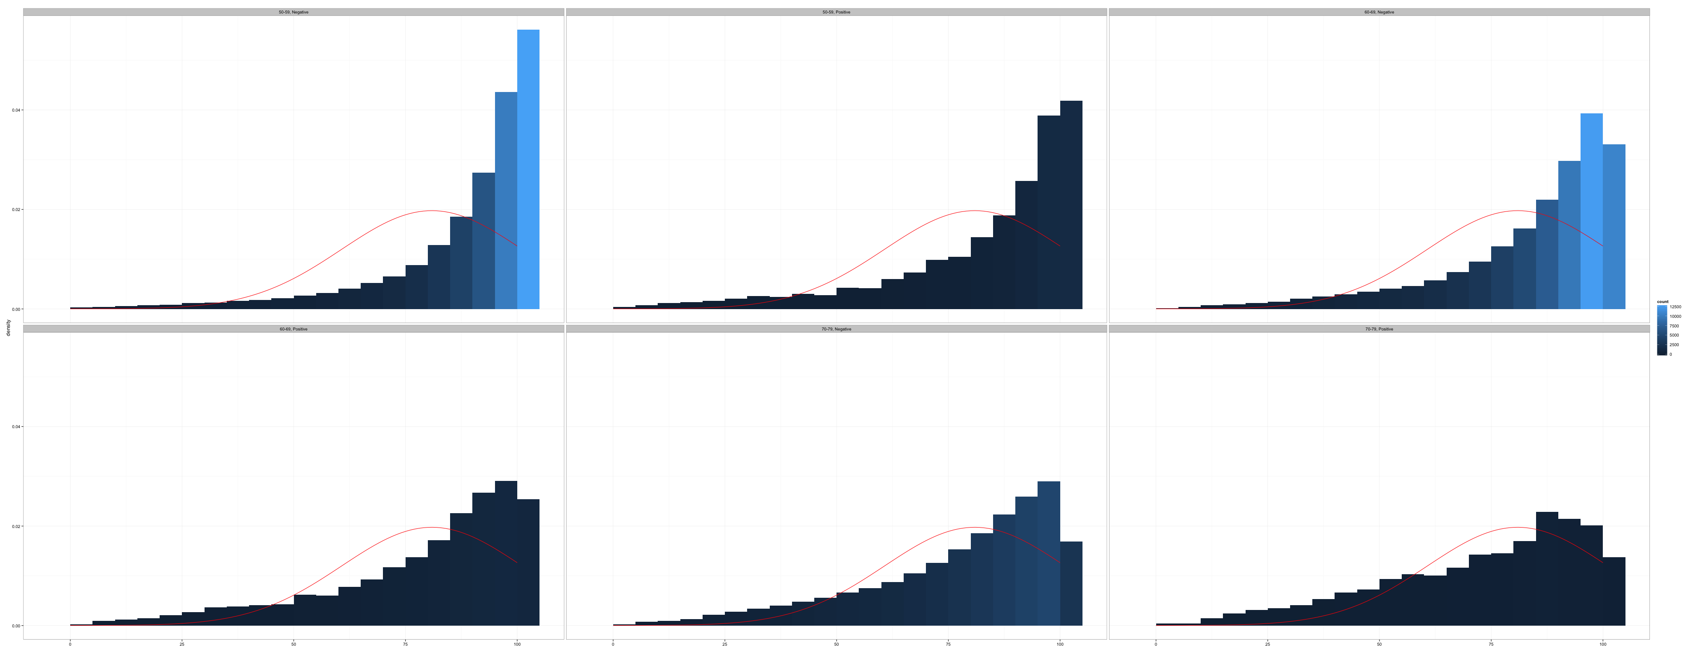
Introduction to Git and GitHub
Introduction to R Programming for Epidemiologic Research

Slide 2



Notes:
The goal of this, and the next few, chapters isn’t to teach you everything you need to know about Git and GitHub. Not even close! That would fill up its own book. The goal here is just to expose you to Git and GitHub, show you a couple of brief examples of how they may be useful to you, and provide you with some resources to learn more if you’re interested. As a side note, most of the graduate assistants working with us these days are expected to learn a little Git and use GitHub when collaborating on our research projects.

Slide 3
Scenario
We are working on a research project…
Emailing code…
Different code versions…
Later, a reviewer wants to see our code…
And, we want to create a simple website to send people to when they are curious about or research project….
Notes:
Let’s start with a scenario. You’ve just been brought on to a research project…. Finish this when you have more energy.

Slide 4
Using Git and GitHub
Introduction to R Programming for Epidemiologic Research

Slide 5
Notes:
In the last chapter, we were introduced to a scenario where it would have been helpful to

Slide 6
Why would you use Git and GitHub?
Versioning
Collaboration
Preservation
Notes:
There are at least three overarching reasons why you should learn to use Git and GitHub as part of your workflow when your projects include data and/or coding:
Versioning
Collaborating
Preservation
We’ll elaborate on what each of these are next. Then, we will introduce you to Git and GitHub and explain why they are some of the best tools currently available to help you with versioning and collaborating. We’ll go ahead and warn you now — this chapter is long because Git and GitHub can be hard to wrap your mind around at first. In fact, using Git and GitHub still frequently causes us confusion and frustration. However, we still believe that the payoff is ultimately worth the upfront investment of time and frustration. Additionally, we will do our best to make this introduction as gentle, comprehensible, and practically applicable as possible.

Slide 7
Versioning
Notes:
Have you ever worked with a

Slide 8
What is Git?
Placeholder

Slide 9
What is GitHub?
Placeholder

Slide 10
Brad’s GitHub Repo
(Remote)
Shirlyn’s GitHub Repo
(Remote)
Kathryn’s GitHub Repo
(Remote)
Brad’s Local Repo
(On my computer)
Shirlyn’s Local Repo
(On my computer)
Kathryn’s Local Repo
(On my computer)

Slide 11
Resources

Slide 12
Demonstration
Topic of Demonstration

Slide 13
References
R4Epi
R Notes
Git book
Happy Git for the useR
Jenny’s Git paper on Paperpile

